Slide 1
Multilayer Perceptron
Eng Teong Cheah

Slide 2
Objective
The multilayer perceptron adds one or multiple fully-connected hidden layers between the output and input layers and transforms the output of the hidden layer via an activation function.

Slide 3
Contents
1. Multilayer Perceptron 2. Hidden Layers 3. ReLU Function 4. Sigmoid Function 5. Tanh Function

Slide 4

Multilayer Perceptron

Slide 5
Hidden Layers

Slide 6
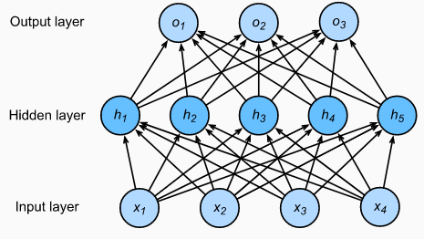
Hidden Layers

Slide 7

ReLU Function

Slide 8
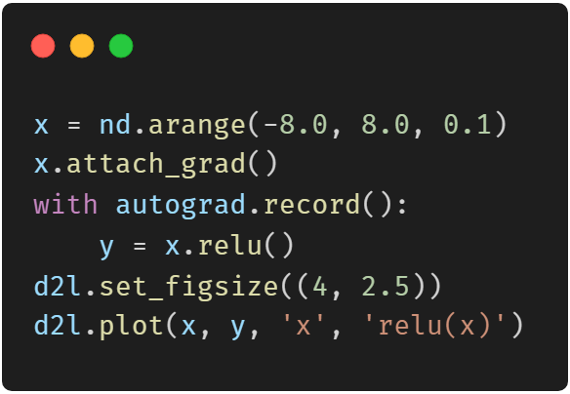
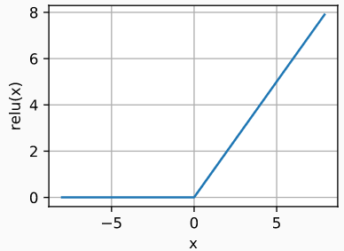
ReLU Function

Slide 9
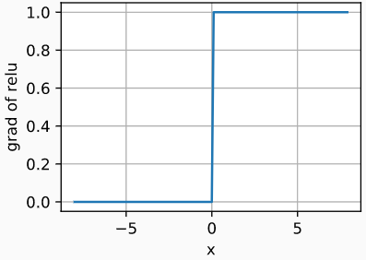
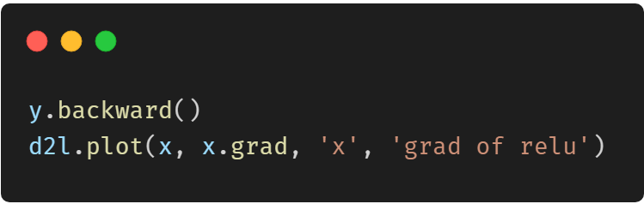
ReLU Function

Slide 10

Sigmoid Function

Slide 11
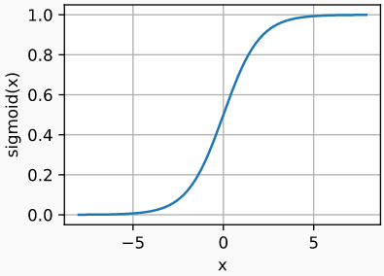
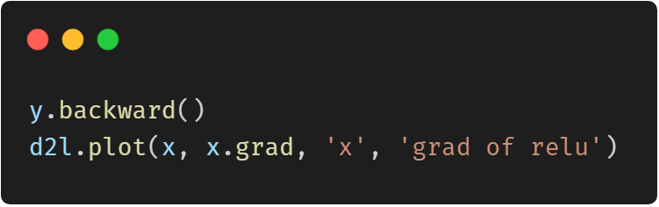
Sigmoid Function

Slide 12
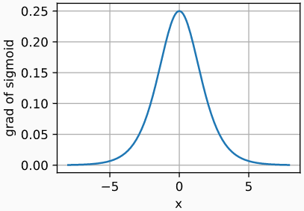
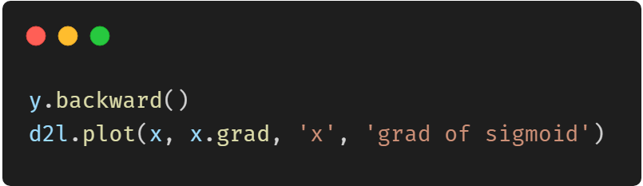
Sigmoid Function

Slide 13

Tanh Function

Slide 14
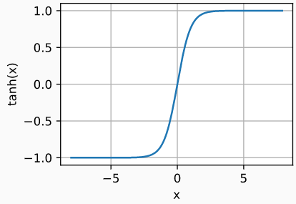
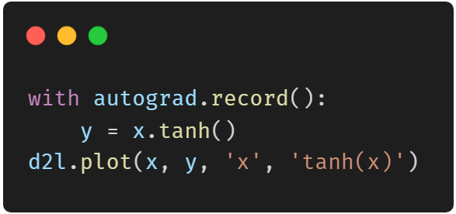
Tanh Function

Slide 15

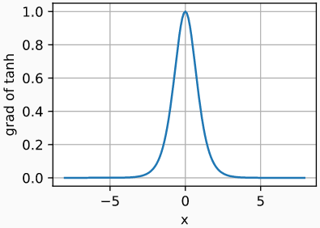
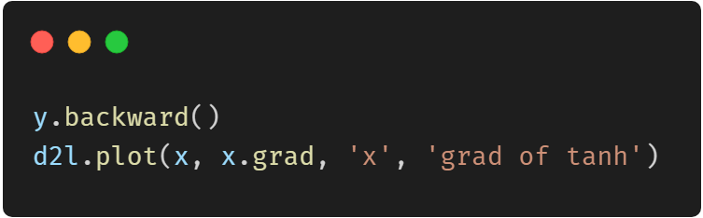
Tanh Function

Slide 16
Thank You！
Does anyone have any questions?
Twitter: @walkercet
Blog: https://ceteongvanness.wordpress.com

Slide 17
Resources
Dive into Deep Learning

